Slide 1

IBM SkillsBuild for Adult Learners - Data Analytics
Data Analytics Internship Program 2024 Final Project Presentation
Project Name: Weather Data Visualization and Analysis
Unique ID: IBM0755
Team Name: Team Algorithm
College Name: Delhi Technical Campus

Slide 2
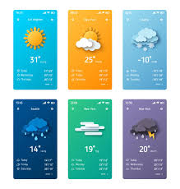
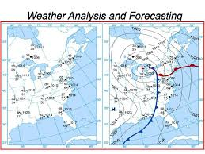
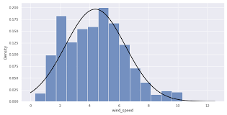
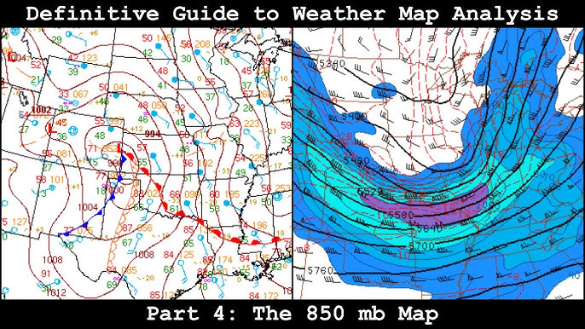
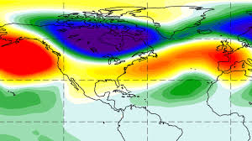
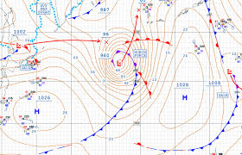
Weather Data Visualization and Analysis

Slide 3
Team Members
ROHIT RAI
SUPRIYO DAS
VIVEK PADIYAR
TEJASVIN DAHIYA
NITESH BARMAN

Slide 4
INTRODUCTION
WEATHER ANALYSIS AND WEATHERFORECASTING.
Weather forecasting simply means prediction of atmospheric conditions like air temperature, humidity, sky conditions, air pressure and general circulation of the atmosphere of a particular place or a region using scientific tools and technological knowledge.
A three-step process that involves observation and analysis, extrapolation to predict future atmospheric conditions, and estimating specific variables

Slide 5
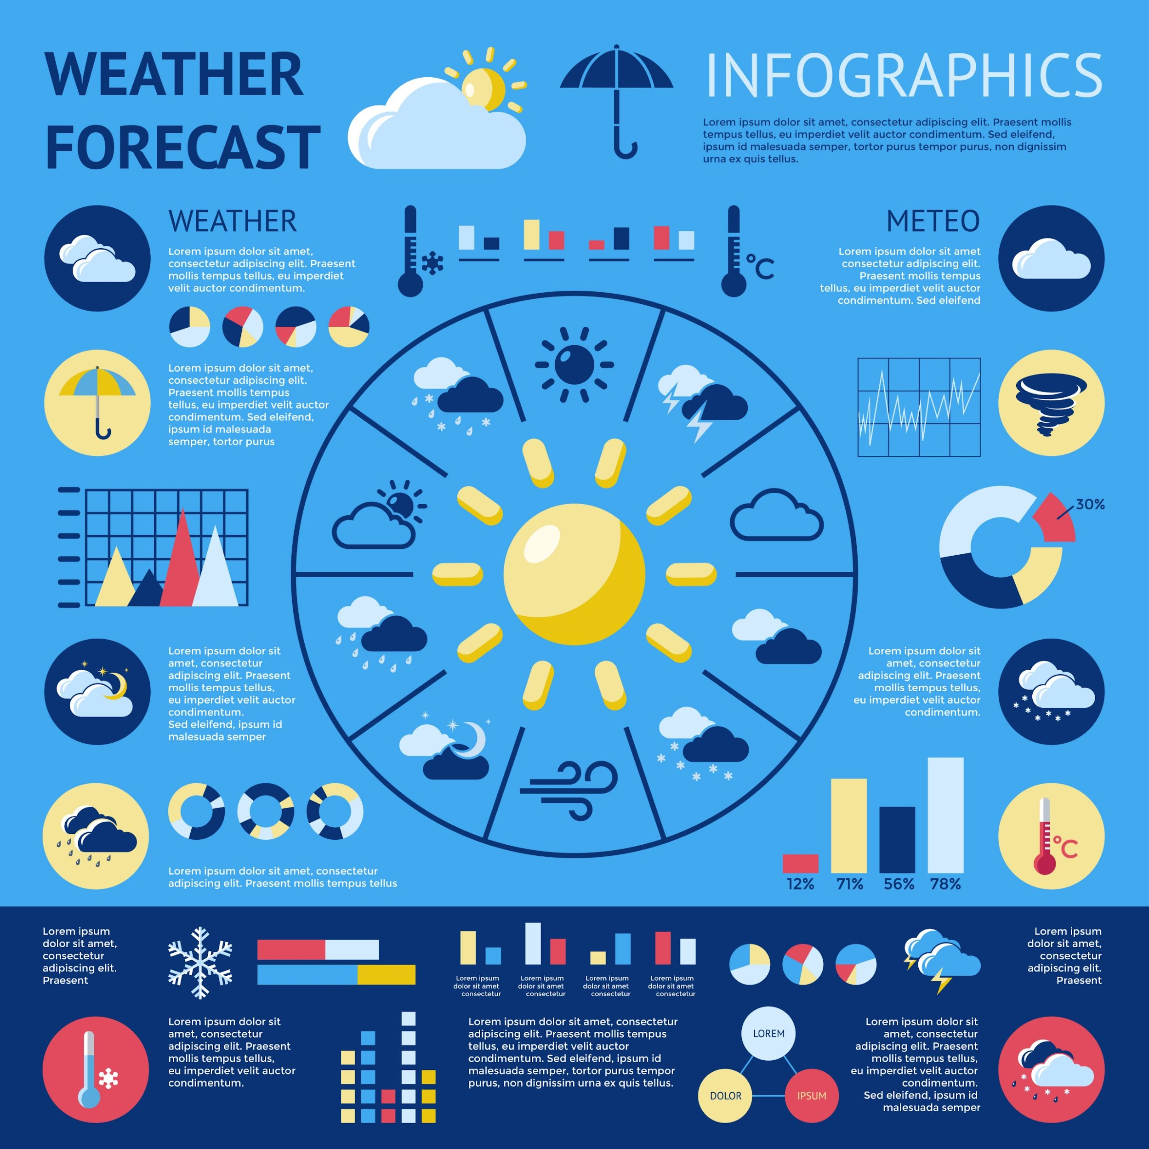
PROJECT SUMMARY
Concept of the Project Weather plays a fundamental role in influencing daily life and shaping economic activities across the globe. Its impact extends to agriculture, disaster management, public safety, and various other sectors.
As climate change continues to alter weather patterns, understanding these changes and their implications becomes increasingly crucial. This project aims to tackle this challenge by focusing on the analysis and visualization of weather data.
The goal is to gain a deeper understanding of climatic patterns and trends through robust data analysis tools and methodologies. By doing so, the project seeks to provide actionable insights that can enhance weather forecasting accuracy, support disaster preparedness, and inform agricultural planning.
This initiative directly aligns with Sustainable Development Goal (SDG) 13: Climate Action, which emphasizes the need for urgent measures to combat climate change and its impacts. Through effective visualization of weather data, we can better understand climatic patterns, anticipate extreme weather events, and develop strategies to mitigate and adapt to the changing climate.

Slide 6
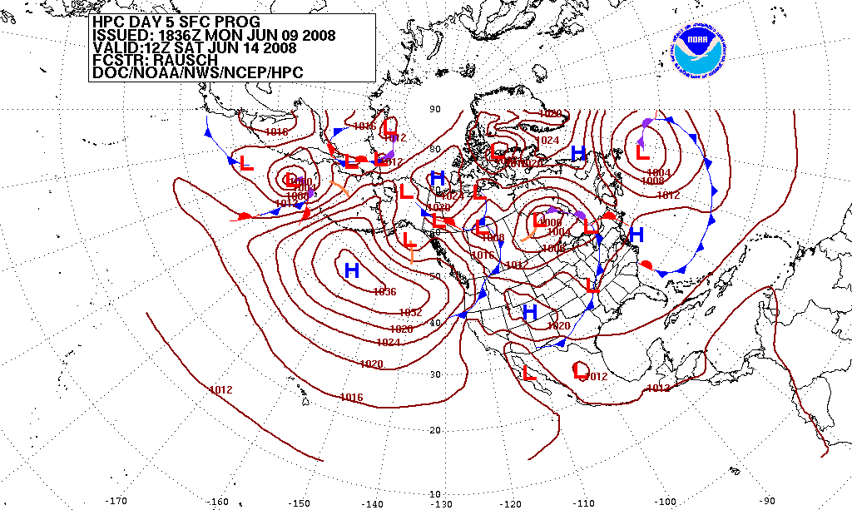
PURPOSE OF THE PROJECT
The primary objective of this project is to analyze and visualize weather data to gain a comprehensive understanding of climatic trends and enhance weather forecasting accuracy.
The project will be carried out in several phases, each contributing to the overall objective of analyzing and visualizing weather data

Slide 7
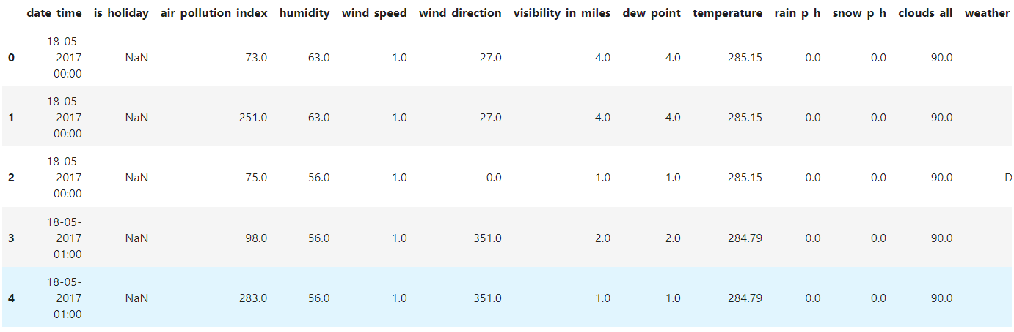
SOURCE OF DATA USED
Data Source - Data is taken from Kaggle. There are several attributes in the data set on the basis of which we are predicting, analyzing, visualizing, the Weather.
Link - https://www.kaggle.com/datasets/ananthr1/weather-prediction

Slide 8
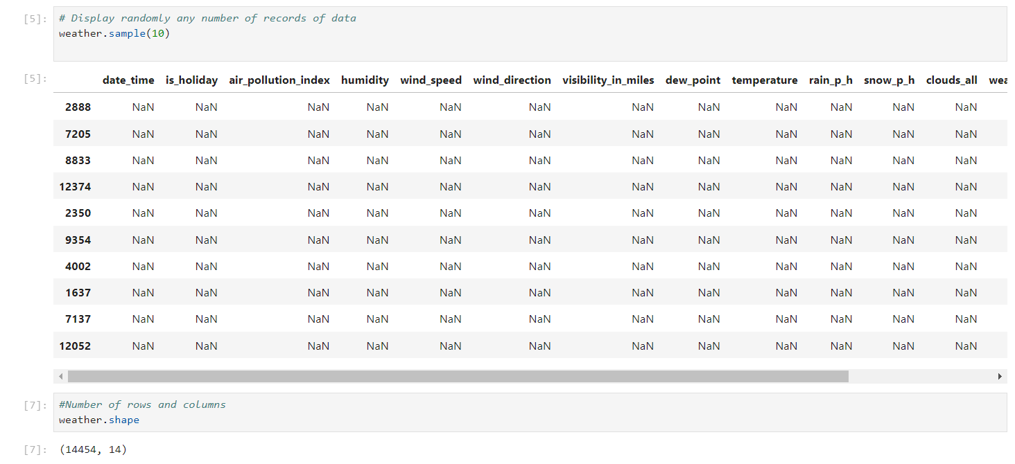
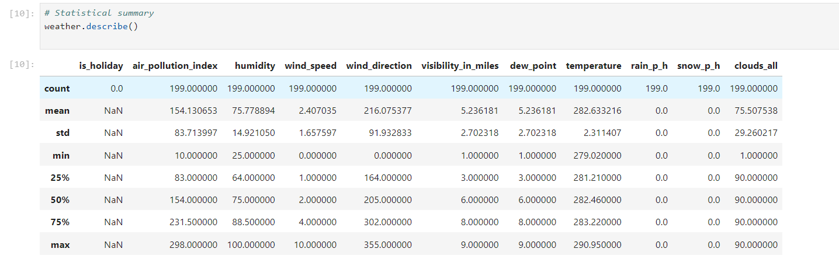
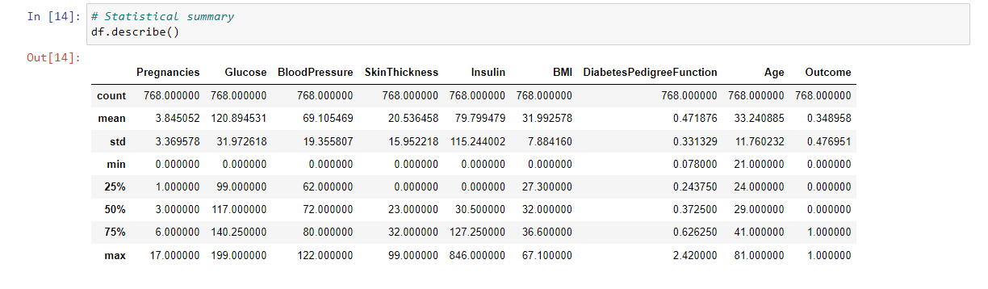
DATA BEFORE CLEANING

Slide 9
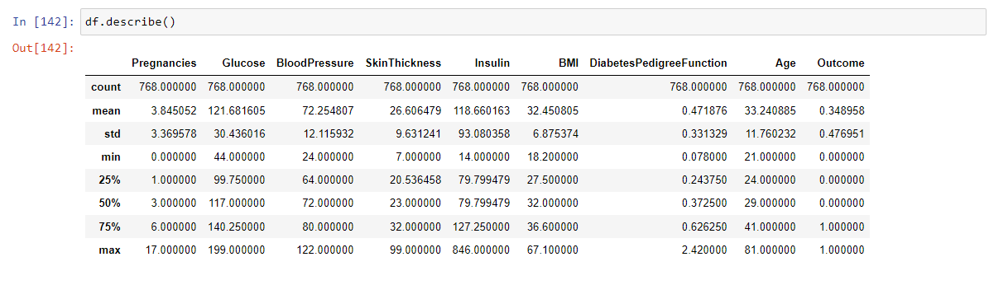
DATA AFTER CLEANING

Slide 10
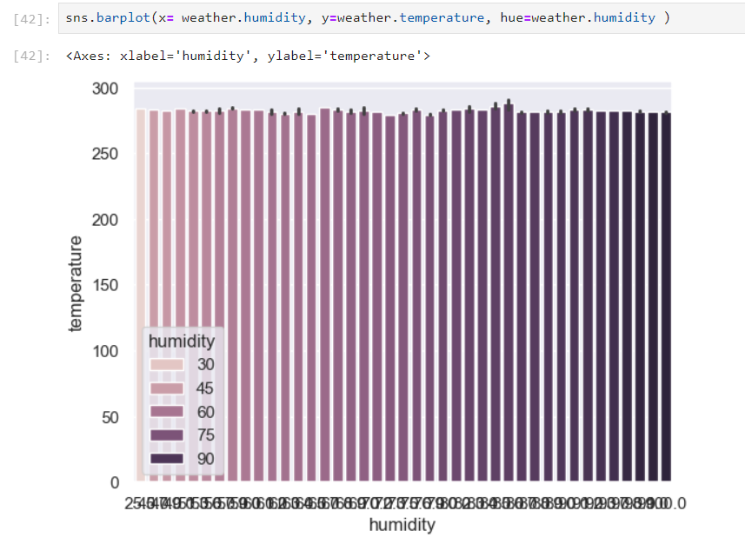
DATA VISUALIZATION
We are showing the data visualizations as follows:
Fig – 1 : Bar Plot

Slide 11
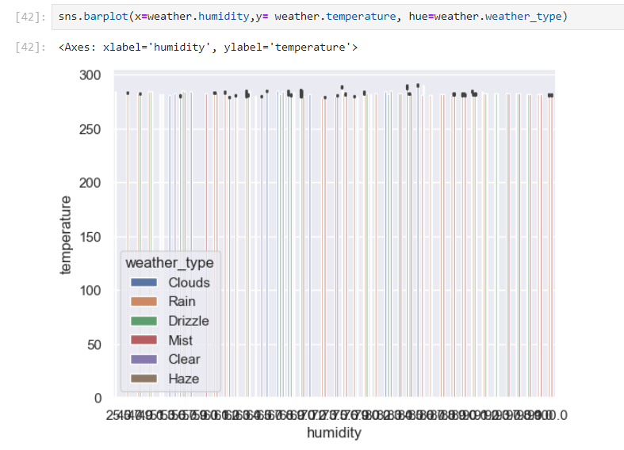
We are showing the data visualizations as follows:

Slide 12
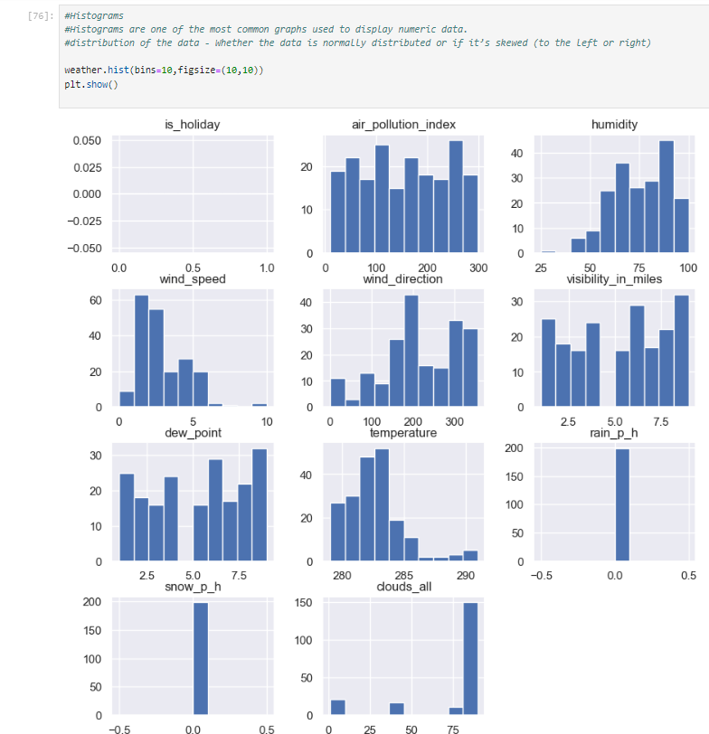
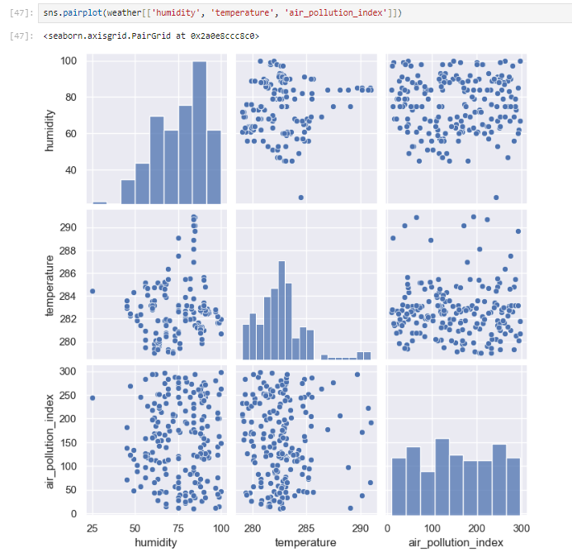
Histogram of the features included in the Dataset
Pair-Plot of the features included in the Dataset
Fig – 2 : Histogram
Fig – 3 :Pair Plot
12

Slide 13
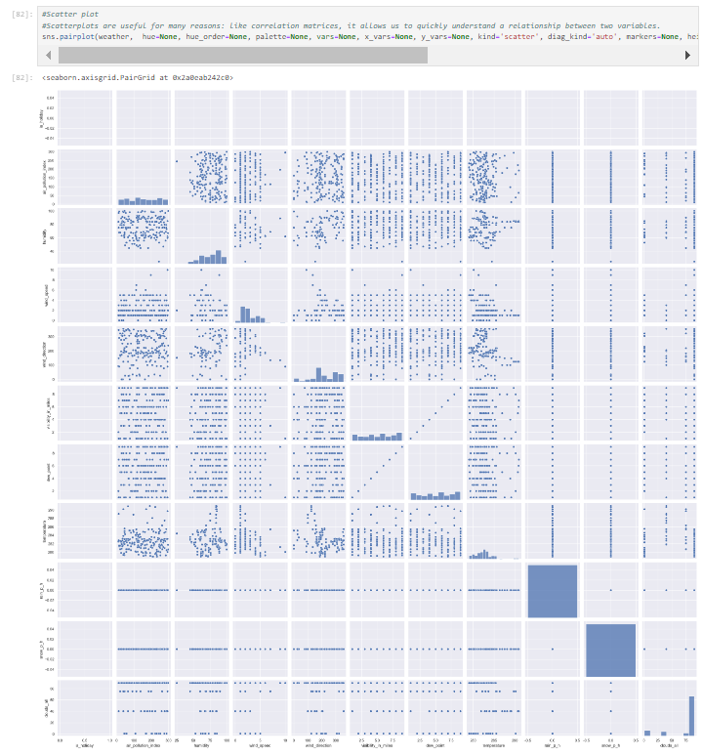
Scatter Plot of the features included in the Dataset
Fig – 4 : Scatter Plot

Slide 14
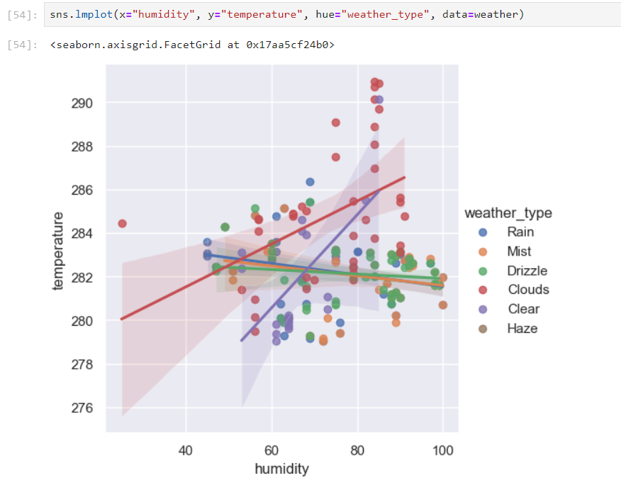
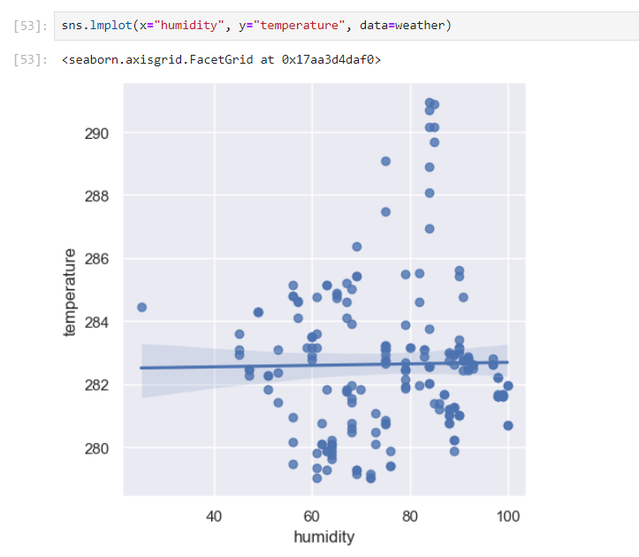
Fig – 5: one of the most basic plots. It shows a line on a 2 dimensional plane

Slide 15
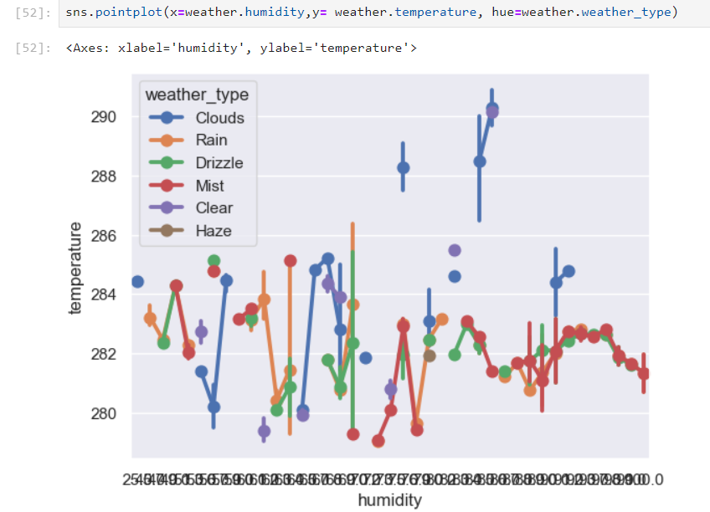
Fig 6: Pair plot
A point plot represents an estimate of central tendency for a numeric variable by the position of the dot and provides some indication of the uncertainty around that estimate using error bars.

Slide 16
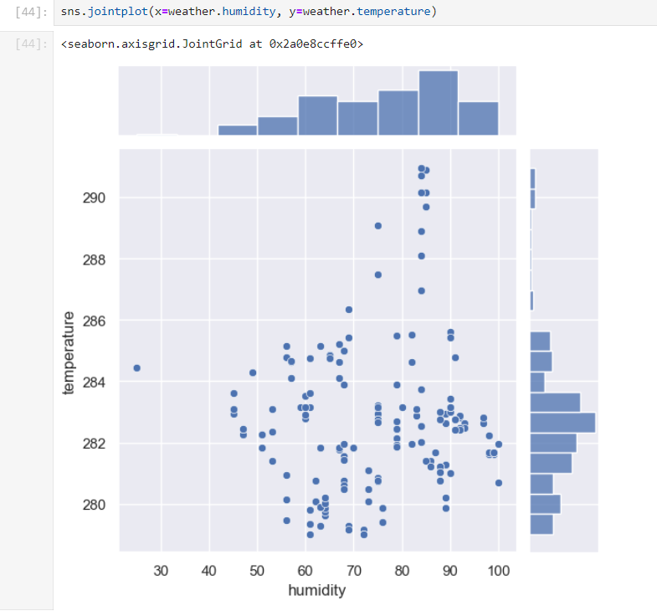
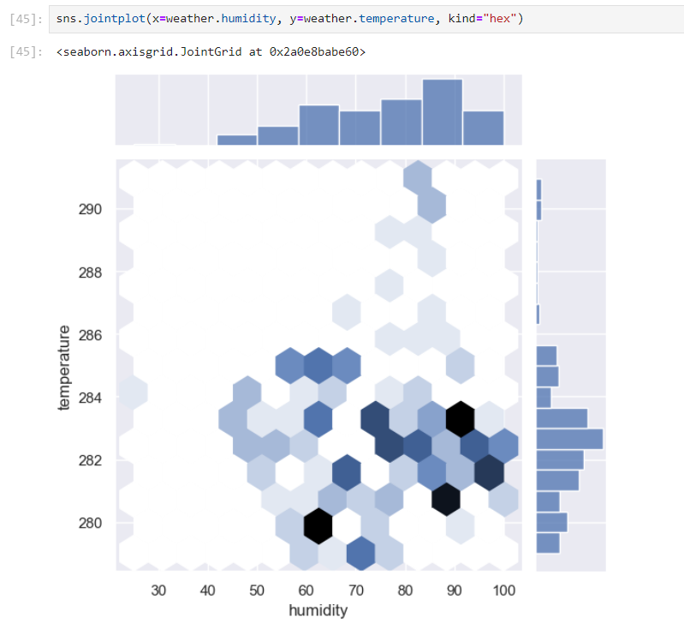
JOIN PLOT
Join plot in a hexagon shape

Slide 17
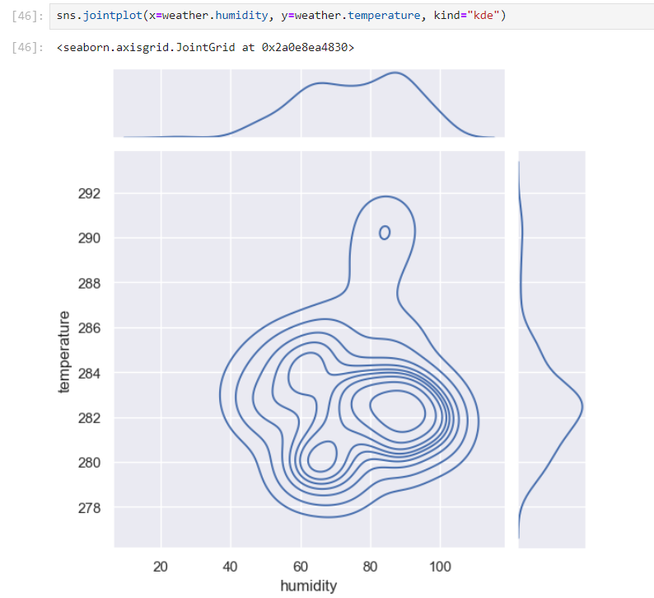
JOIN PLOT
kernel density estimate (KDE) plot is a method for visualizing the distribution of observations in a dataset, analogous to a histogram.

Slide 18
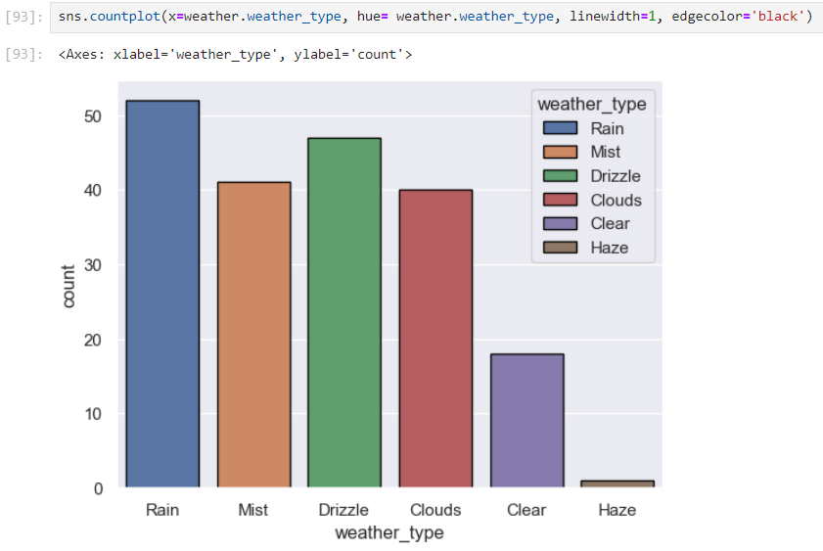
COUNT PLOT
A count plot is a type of visualization that uses bars to show the number of observations in each category of a data set. It's a type of categorical plot, which is often used to compare different groups. Count plots can be thought of as histograms across categorical variables, and they can be useful for exploratory data analysis

Slide 19
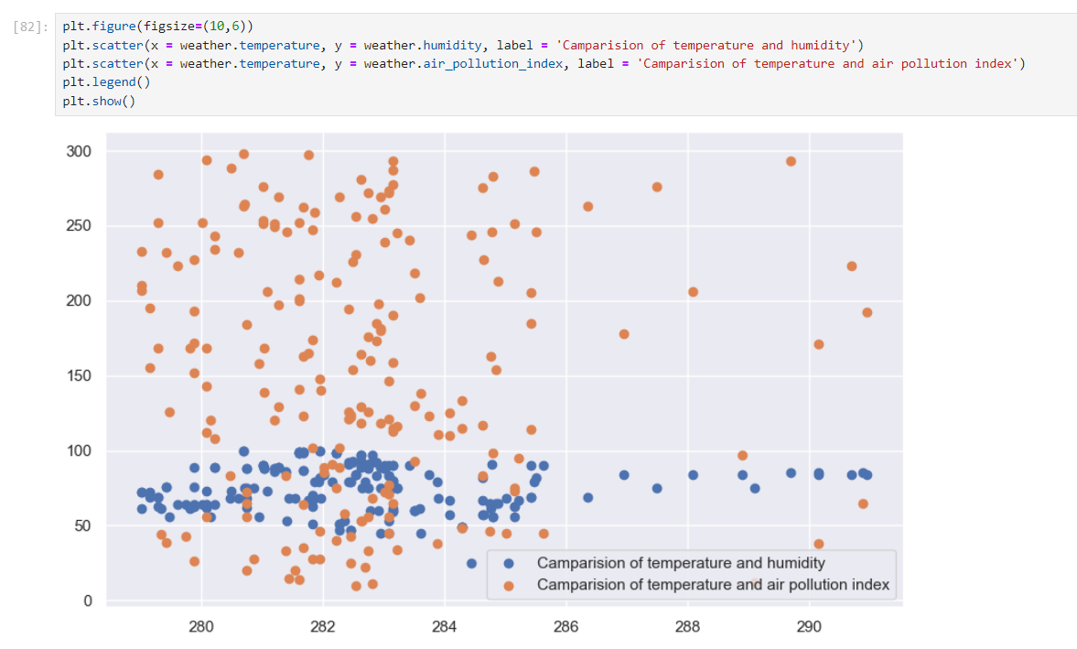
Comparison of Temperature and Humidity
Comparison of Temperature and Air pollution

Slide 20
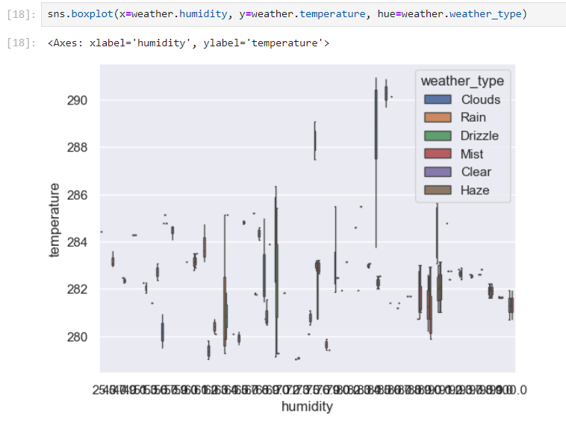
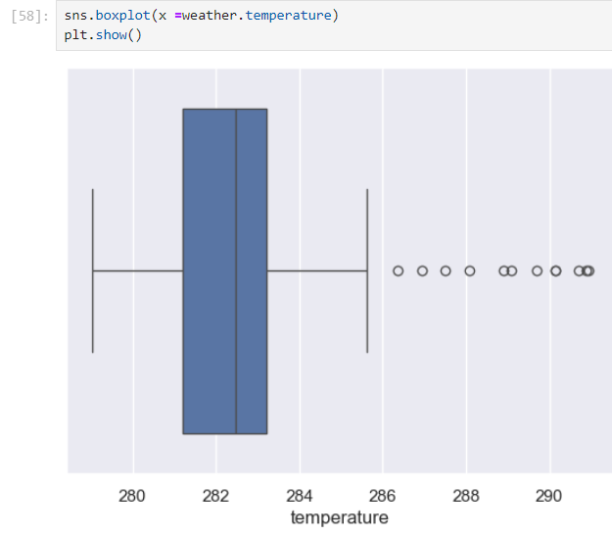
Box Plot

Slide 21
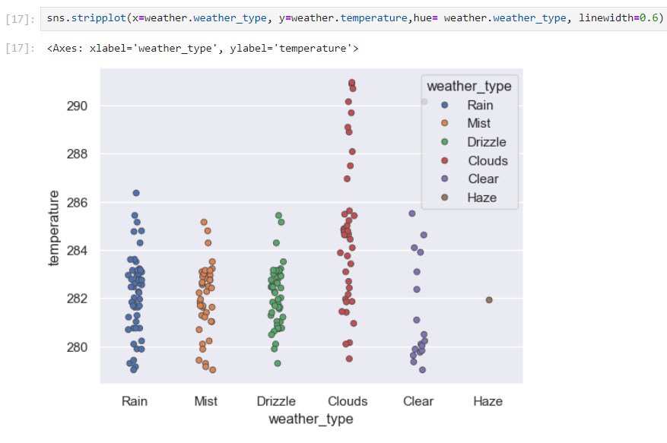
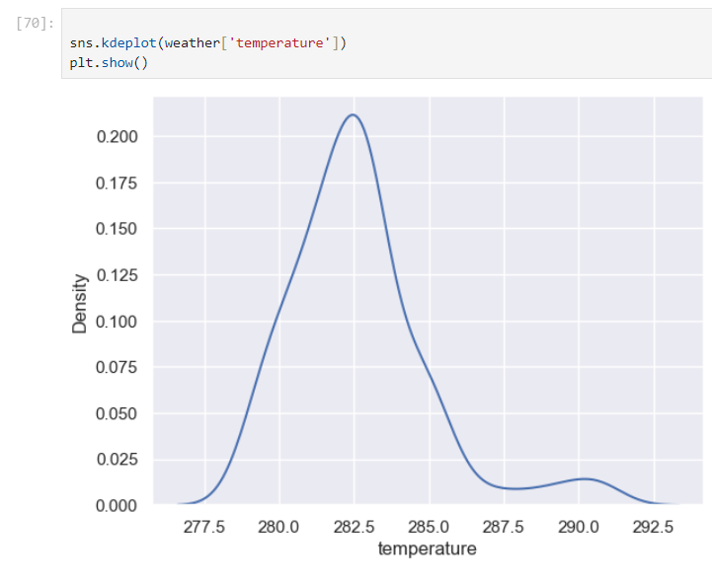
Stripplot of the features included in the Dataset
KDE Plot of the features included in the Dataset

Slide 22
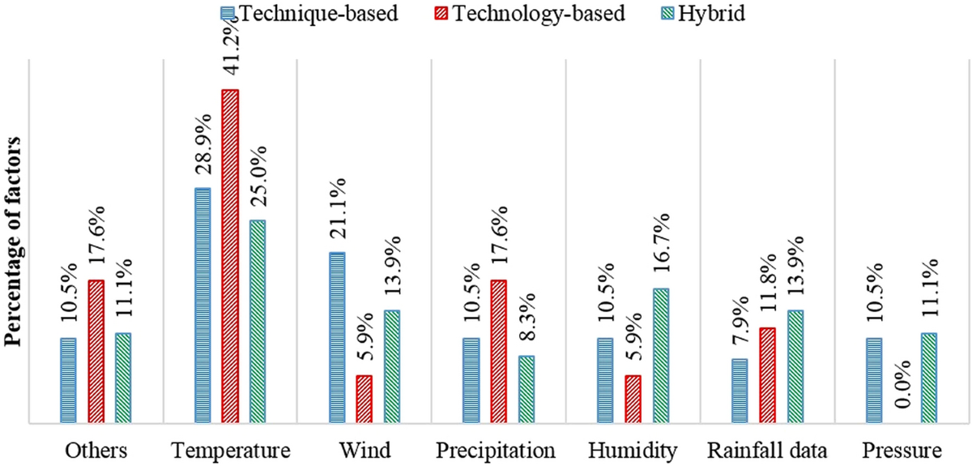
CONCLUSION
Summary: - Weather data visualization and analysis effectively identify significant trends and anomalies. - These insights are crucial for enhancing decision-making across various sectors.
Impact of Proposed Solution: - Improved accuracy and clarity in weather predictions. - Enhanced preparedness and response to climatic events, benefiting agriculture, disaster management, urban planning, transportation, and energy management.
Future Work: - Development of more sophisticated visualization tools. - Integration with real-time data and advanced predictive models. - Expansion of applications to address new climate challenges and promote sustainable development.

